Slide 1
Crossing the B-Line
Notes:
Start with all 6 Bricks on the red line – in any order
Always move bricks in a straight line – from line to line

Slide 2
Crossing the B-Line
Horizontal Mat
Start with all 6 Bricks on the red line in any order.
Notes:
Start with all 6 Bricks on the red line – in any order
Always move bricks in a straight line – from line to line

Slide 3
Crossing the B-Line
up
down
red
up
yellow down
Player
Notes:
Player must imagine they are standing on the red line
Up = move brick up – one line
Down = move brick down – one line

Slide 4
Crossing the B-Line
forward
backward
yellow backward
red forward
Player
Notes:
Player must imagine they are standing on the red line
Up = move brick up – one line
Down = move brick down – one line

Slide 5
Crossing the B-Line
Only move bricks if they have to be moved NB – leave if already correct
in front of
behind
orange
behind yellow
dark blue
in front of red
Player
Notes:
Player must imagine they are standing on the red line
Up = move brick up – one line
Down = move brick down – one line

Slide 6
Crossing the B-Line
Start with all 6 Bricks on the red line in any order.
Vertical Mat
Notes:
Start with all 6 Bricks on the red line – in any order
Always move bricks in a straight line – from line to line

Slide 7
Crossing the B-Line
left
right
red
right
yellow
left

Slide 8
Crossing the B-Line
left of
right of
yellow
left of
green
dark blue
right of
red

Slide 9
Crossing the B-Line
Vertical Mat
Partners – Same Side
Horizontal Mat
Player 2
Player 1
Player 2
Player 1
Notes:
Great option if you only have a few mats - or if you want people to work in pairs.
Same Sides - To be used with : Normal horizontal & vertical movement Templates

Slide 10
Crossing the B-Line
Vertical Mat
Player 1
Partners – Opposite Sides
Horizontal Mat
Player 1
Player 2
Player 2
Notes:
Great option if you only have a few mats - or if you want people to work in pairs.
Opposite Sides - To be used with Task Template for working with a Partner
( every second line is highlighted : green = horizontal mat / orange = vertical mat )

Slide 11
Crossing the B-Line
line value
positional value
5
4
4
3
2
2
red
4
yellow 2
1
Player
Notes:
Player must imagine they are standing on the red line
Up = move brick up – one line
Down = move brick down – one line

Slide 12
Crossing the B-Line
addition
subtraction
answer
5
4
+1
3
-2
2
dark blue
+1
yellow -2
1
Player
Notes:
Player must imagine they are standing on the red line
Up = move brick up – one line
Down = move brick down – one line

Slide 13
Crossing the B-Line
addition
Subtraction
by brick
5
4
green+1
3
light blue
-2
2
red to
green +1
orange to light blue -2
1
Player
Notes:
Player must imagine they are standing on the red line
Up = move brick up – one line
Down = move brick down – one line

Slide 14
Crossing the B-Line
addition
Subtraction
by brick
5
4
1 + 3
3
4 - 3
2
yellow to green + orange
green to dark blue – light blue
1
Player
Notes:
Player must imagine they are standing on the red line
Up = move brick up – one line
Down = move brick down – one line

Slide 15
Crossing the B-Line
When twisting and flipping – always use brick in its current state (shape)
twist
flip
yellow twist
yellow flip
Player

Slide 16
Crossing the B-Line
flipped
twisted
orange
behind
flipped yellow
twisted light blue in front of
dark blue
Player

Slide 17
Crossing the B-Line
flipping twist
twisted light blue in front of
flipped yellow
Player

Slide 18
Crossing the B-Line
base 10
- / +
÷ / x
5
10
4
9
Start with all 6 Bricks
in any position in any order
3
8
2
7
1
6
Player

Slide 19
Crossing the B-Line
base 10
addition
subtraction
multiplication
division
5
10
4
9
3
8
orange
to
10 - 7
dark blue
to
3 + 4
red
to
2 x 4
green
to
8 ÷ 2
2
7
1
6
Player
Notes:
Player must imagine they are standing on the red line
Up = move brick up – one line
Down = move brick down – one line

Slide 20
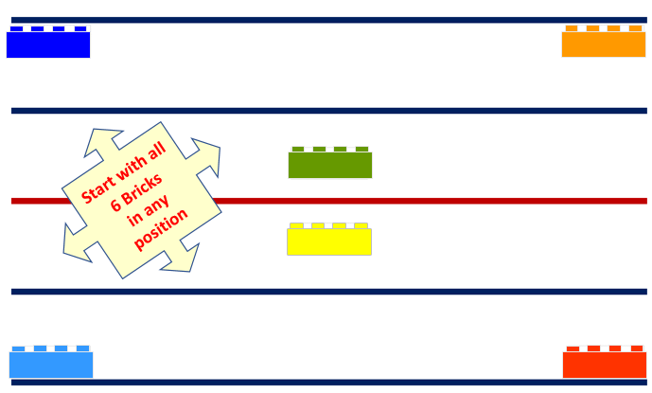
Working Memory
Crossing the B-Line
Can work in pairs / with a partner / with the teacher / with a parent
First person : memorizes the layout - then looks away when ready
Next person : swops ( by moving ) two of the bricks
First person : tries to identify which two bricks were swopped

Slide 21
Drop all the bricks in one go - from 20cm above the Red line
Crossing the B-Line
- how many bricks landed on a line ?
- how many bricks landed between lines ?
- how many bricks landed on their side ?
- how many bricks landed off the mat ?
- how many bricks land upside down - on their studs ?
- how many bricks landed to the (left or right of) (above or below) the red line ?
- how many bricks touched line No. 1 / 2 / 3 / 5 - grey rectangles ?
- ( If line 1 = 1, line 2 = 2, etc ) what is the value of the bricks touching lines ?
- how many studs are facing up / down / to the side ?
Notes:
Sorting
Drop all the bricks in one go - from 20cm above the Red line Questions to ask :
- how many bricks landed on a line ? - how many bricks landed between lines ? - how many bricks landed on their side ? - how many bricks land upside down - on their studs ? - how many bricks landed to the (left or right of) (above or below) the red line ? - how many bricks landed off the mat ? - how many bricks touched line No. 1 / 2 / 3 / 5 - grey rectangles ? - ( If line 1 = 1, line 2 = 2, etc ) what is the value of the bricks touching lines ? - how many studs are facing up / down / to the side ?

Slide 22
Crossing the B-Line
Player 1
symmetry
mirror image
spatial
Player 2
Notes:
Symmetry - Start with bricks off the mat.
Can work in pairs / with a partner / with the teacher / with a parent Player 1 : lays down a starting brick in any orientation touching the red line Player 2 : lays down the same colour brick to mirror the first brick Player 1 : adds bricks one at a time to create a pattern Player 2 : lays down the same colour bricks to complete the mirror image / pattern After completing - Player 2 has a turn to start and build a pattern
advance to not starting on the red line
advance to 2, then 3, 4, 5 and eventually 6 bricks at a time

Slide 23
Thank You

